Slide 1

Nursing Home Quality in Oklahoma
Ayan Ajanaku
Morgan Missel
Demekia Medley

Slide 2

There are 297 nursing homes in Oklahoma homing with approximately 17,213 seniors.

Slide 3

- Compare the staff-turnover rate and the QM (Quality Measure) rating - Compare the number of fines and the number of staff onsite during the day to see if more staff means less or more fines. -Do the fines correlate to the QM rating and ownership?

Slide 4
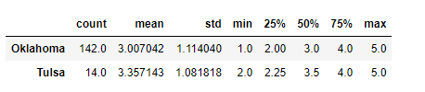
Exploratory Data
Quality Measure Discover Statistics for Oklahoma and Tulsa

Slide 5
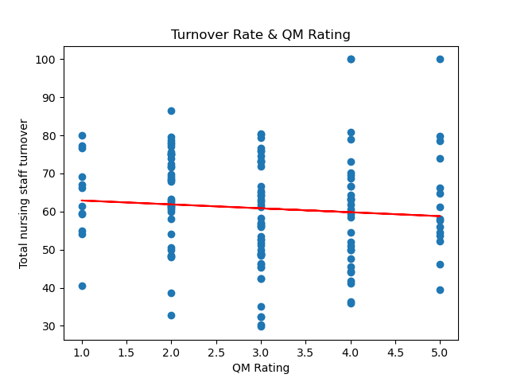
Turnover and the QM Rating
The P value between total nursing staff turnover and QM rating 0.34.

Slide 6
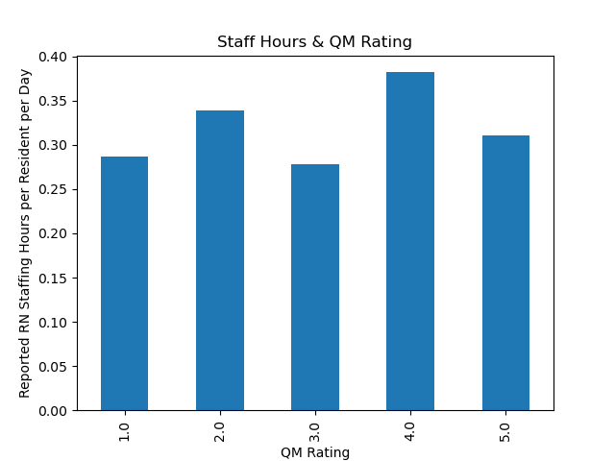
RN Staff Hours Affected by QM Rating

Slide 7
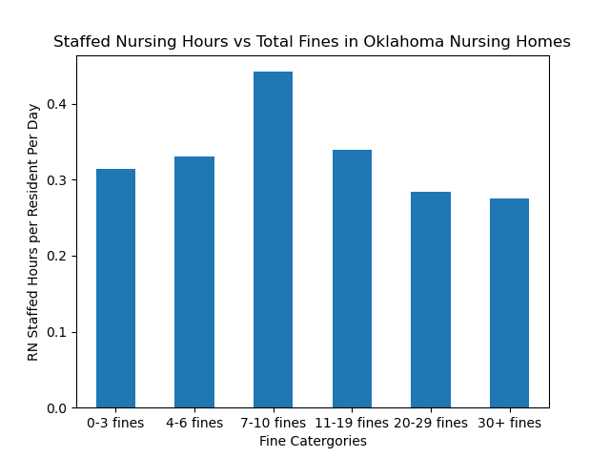
Staffed Nursing Hours vs Total Fines

Slide 8
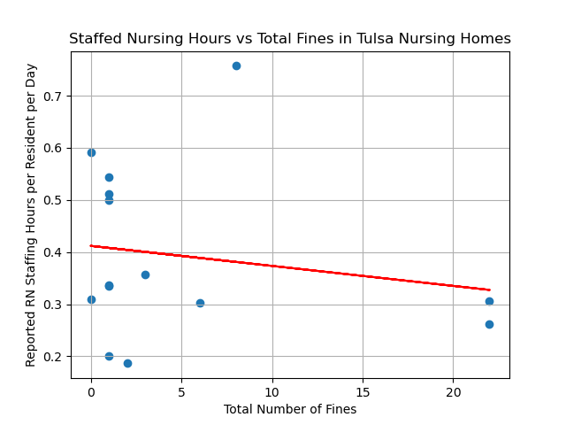
Staffed Nursing Hours vs Total Fines
The correlation is -0.18 and the p_value is .54

Slide 9
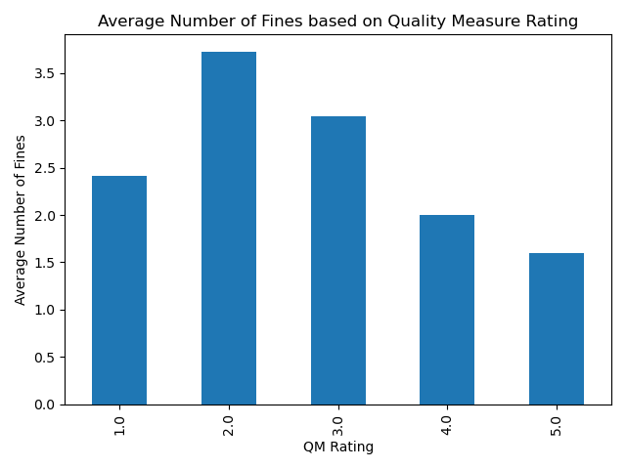
Average Number of Fines and Quality Measure

Slide 10
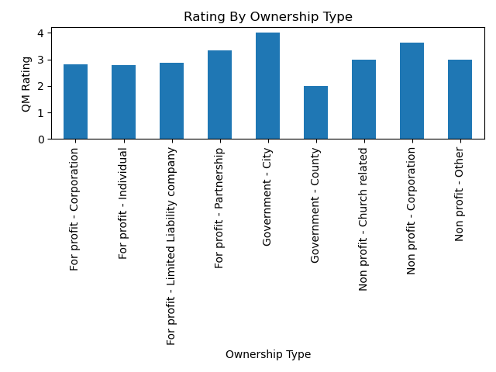
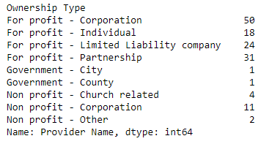
Ownership Type vs QM Rating

Slide 11
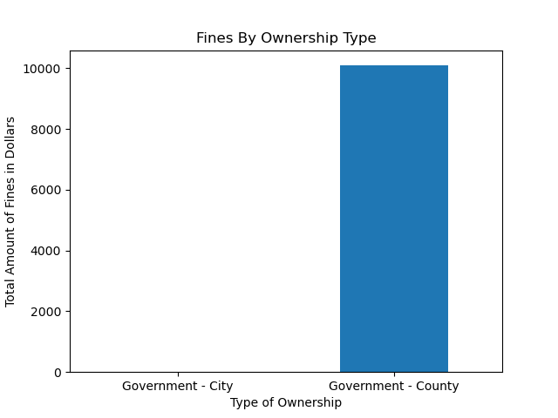
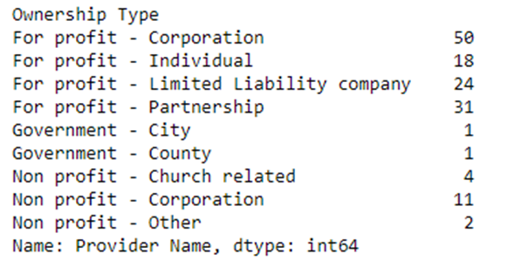
Ownership Type vs Total Fines in $

Slide 12
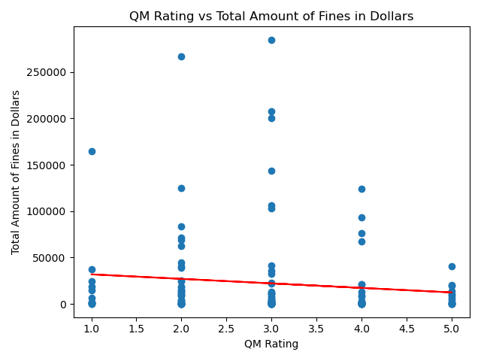
Total Amount of Fines vs QM Rating
The correlation is -0.11 and the p_value is

Slide 13
Conclusion
Staff turnover and the number of hours spent with residents does not have a correlation with Quality Measure Rating.
The time spent with patients also does not appear to have a large effect on the number of fines incurred by a home. The number of fines has a slight affect on the QM rating.
Ownership does not have a large effect on Quality Measure Rating
Quality Measure Rating is a difficult measure to quantify

Slide 14
Thank you!
Questions?

